Slide 1
15-8 Triple Integrals in Cylindrical and
Spherical Coordinates

Slide 2
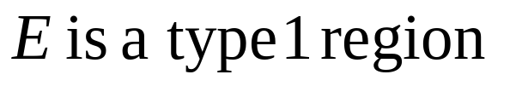
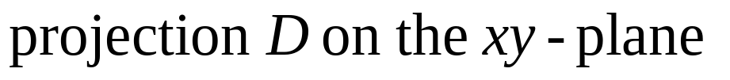
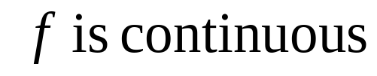

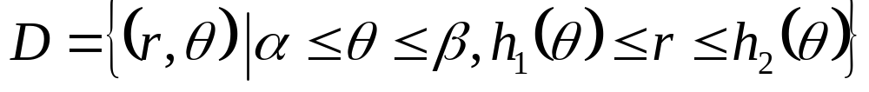
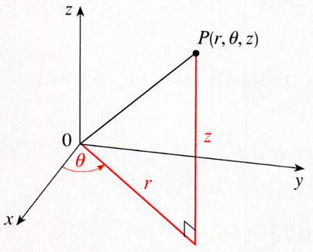
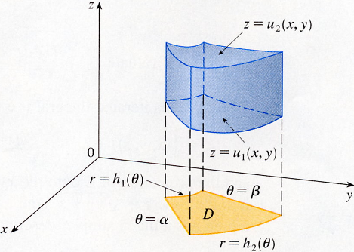

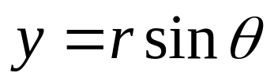
Cylindrical Coordinates
z=u₂(x, y)
P(r,θ,z)
Z
z=u₁(x, y)
θ
r
r=h₁(θ)
θ=β
θ=α
D
r=h₂(θ)

Slide 3
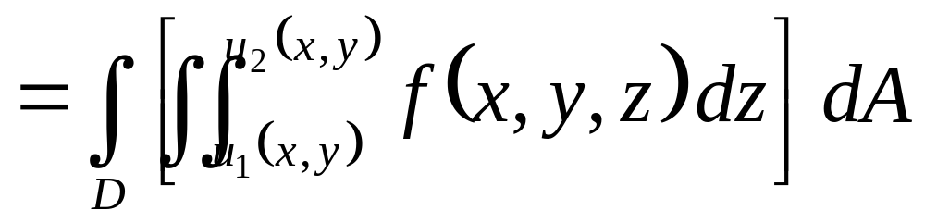
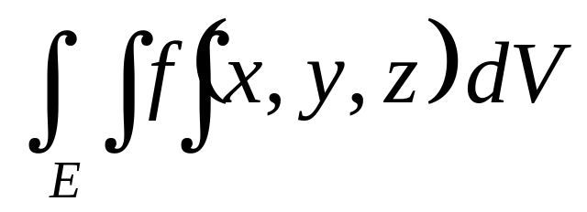
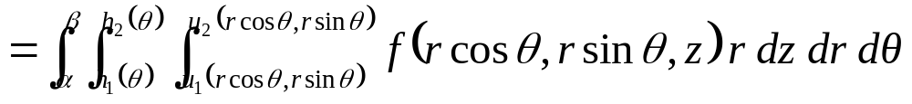
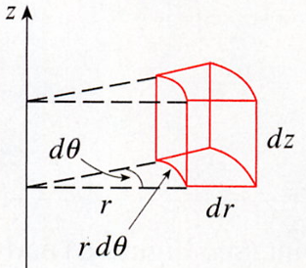
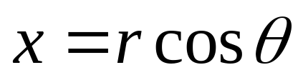
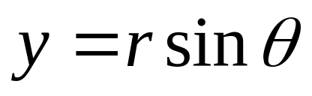
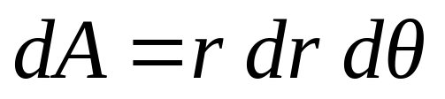
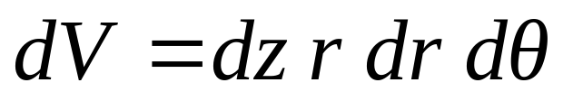
Formula for triple integration in cylindrical coordinates.
dθ
dz
r
dr
rdθ

Slide 4
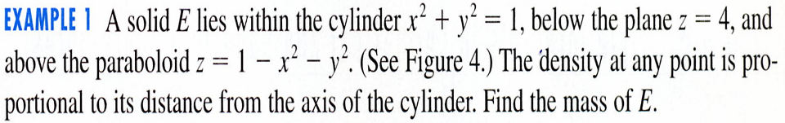

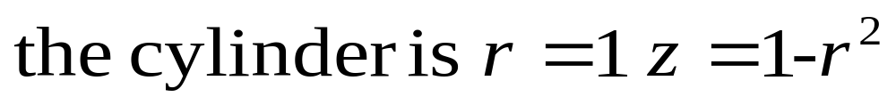
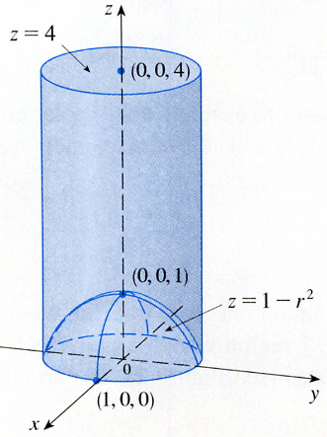
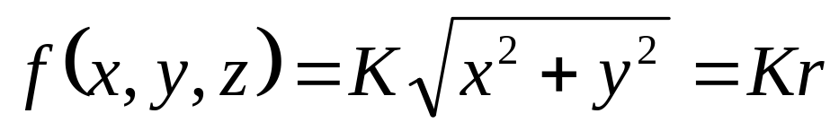
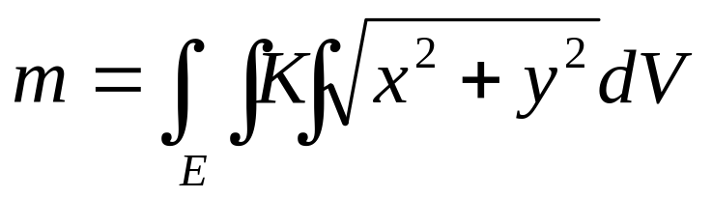
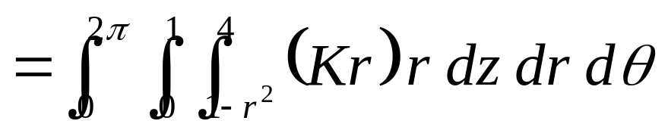
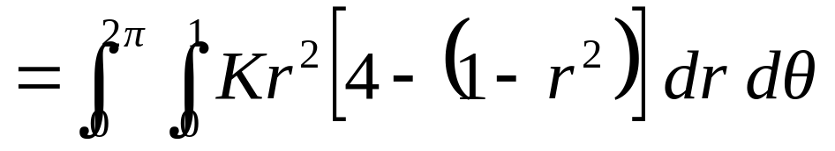
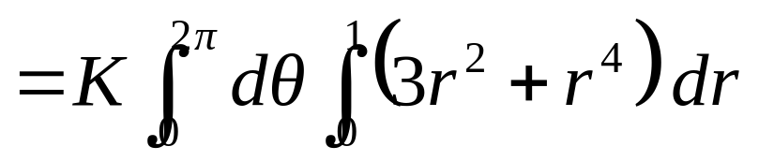
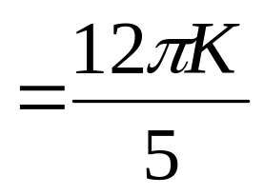
EXAMPLE 1
SOLUTION
,
Z=4
(0,0,4)
density
K is constant
(0,0,1)
z=1-r²
(1,0,0)

Slide 5
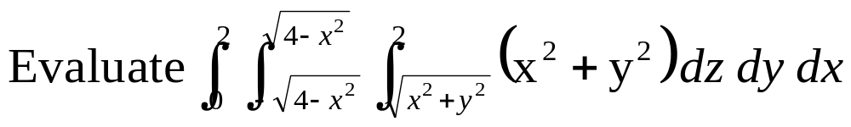
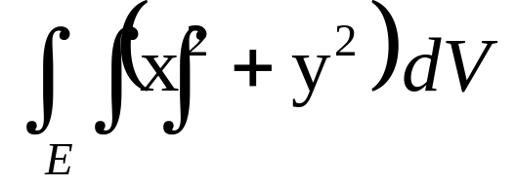
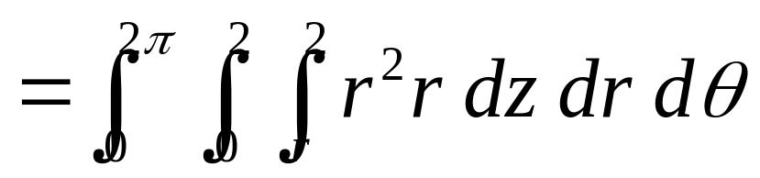
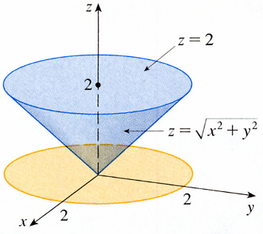
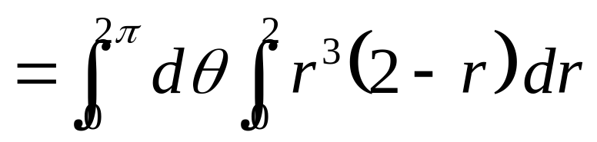
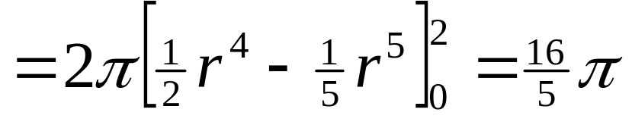
EXAMPLE 2
-2
SOLUTION
z=2
2
z= x²+y²
2
2

Slide 6
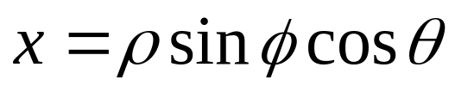
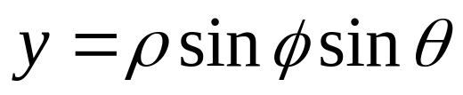
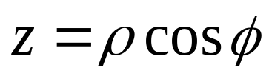
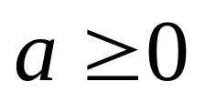
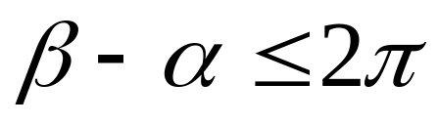
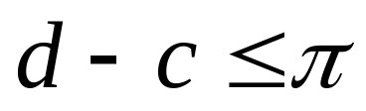
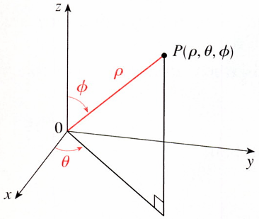
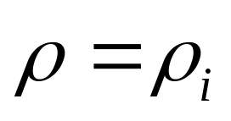
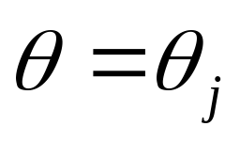
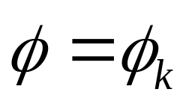
Spherical Coordinates
Spherical wedge
P(ρ,θ,φ)
Divide E into smaller
ρ
φ
φ
spherical wedges E_{ijk}
ρcosφ
θ
ρsinφ

Slide 7
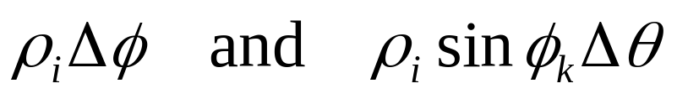
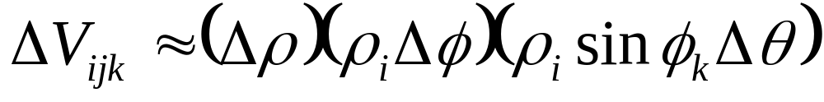
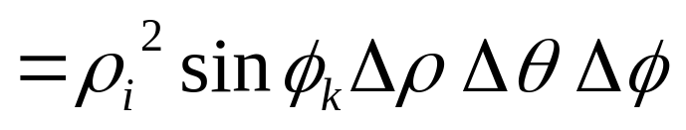
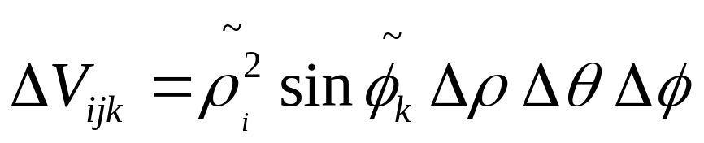
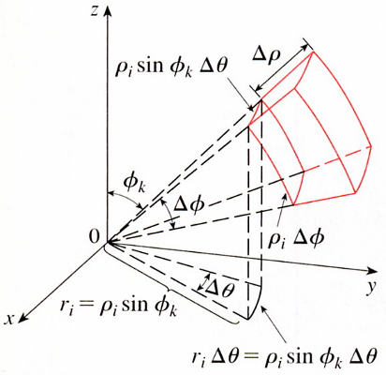
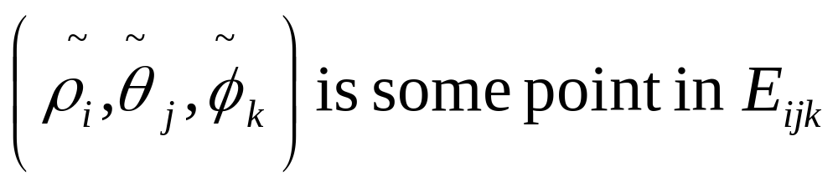
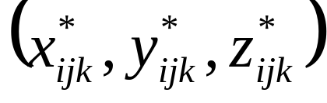
the volume of E_{ijk}
△ρ
ρ_{i}sinβ_{k}△θ
φ
φ_{k}
△φ
ρ_{i}△φ
rectangular coordinates
r_{i}=ρ_{i}sinφ_{k}
r_{i}△θ=ρ_{i}sinφ_{k}△θ
- Z

Slide 8
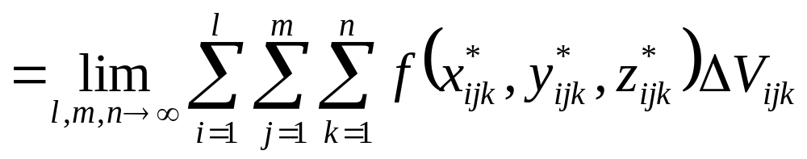

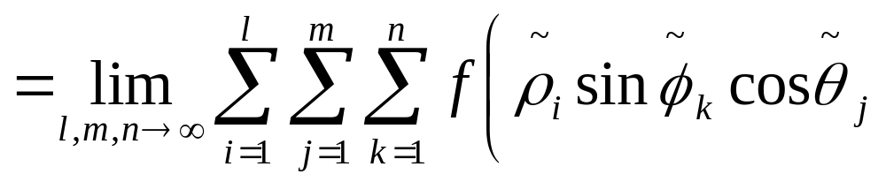
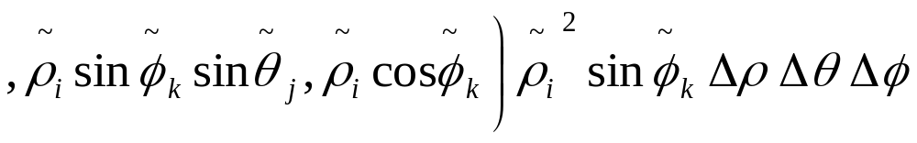
△ρ
ρ_{i}sinφ_{k}△θ
φ_{k}
△φ
ρ_{i}△φ
r_{i}=ρ_{i}sinφ_{k}
r_{i}△θ=ρ_{i}sinφ_{k}△θ
- Z

Slide 9





Riemann sum for the function
formula for triple integration in spherical coordinates.
ρsinφdθ
dρ
ρ
φ
ρdφ
dθ
- Z

Slide 10



ρsinφdθ
dρ
ρ
φ
ρdφ
dθ

Slide 11







EXAMPLE 3
SOLUTION
Rectangular coordinates

Slide 12












EXAMPLE 4
Use spherical coordinates to find the volume of the solid that
SOLUTION
0≦ρ≦
x²+y²+z²=z
π
4
z= x²+y²
0≦ψ≦π/４

Slide 13







x²+y²+z²=z
π
4
z= x²+y²

Slide 14
15-8 Exercises
EX3，EX29

